Slide 1
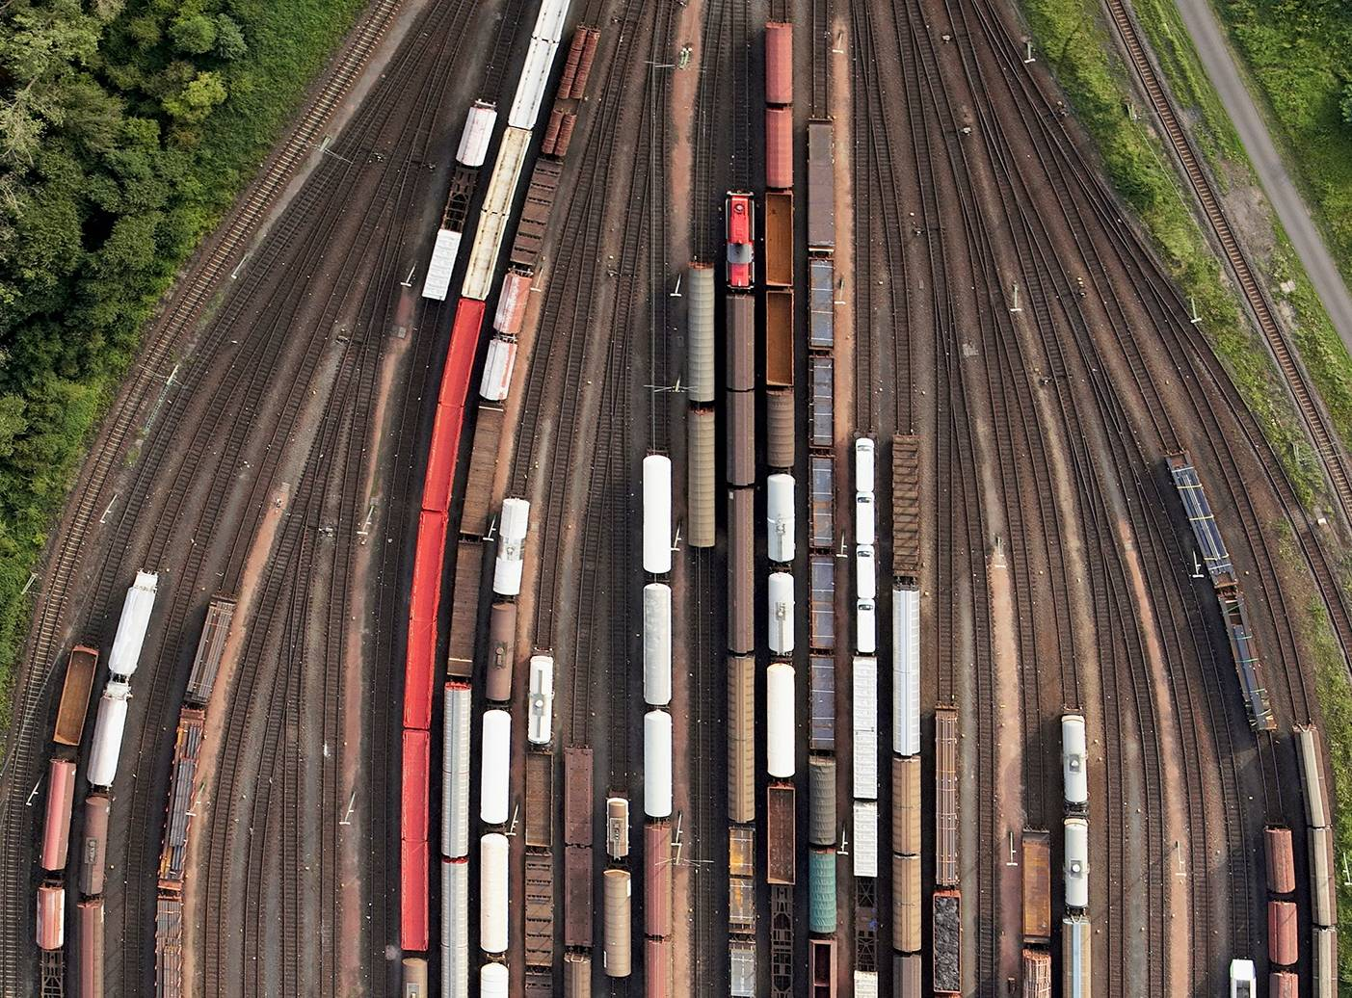



CHAPTER 3: DESCRIBING DATA SOURCES
PRINCIPLES OF
DATA INTEGRATION
ANHAI DOAN ALON HALEVY ZACHARY IVES

Slide 2
Motivation and Outline
Descriptions of data sources enable the data integration system to:
  Determine which sources are relevant to a query
  Access the sources appropriately
  Combine data from multiple sources
  Overcome limitations that specific sources may have
  Identify opportunities for more efficient query evaluation
Source descriptions are a formalism for specifying the important aspects of data sources.

Slide 3
Outline
Introduction to semantic heterogeneity
Schema mapping languages
Access pattern limitations
Integrity Constraints on the mediated schema
Answer completeness
Data-level heterogeneity

Slide 4
Query reformulation
Query
Logical query plan
Query optimizer
Physical query plan
Execution engine
Re-planning request
wrapper
wrapper
wrapper
wrapper
wrapper
source
source
source
source
source

Slide 5
Schema Heterogeneity
Schema heterogeneity is a fact of life.
  Whenever schemas are designed by different people/organizations, they will be different, even if they model the same domain!
The goal of schema mappings is to reconcile schema heterogeneity:
  Mostly between the mediated schema and the schema of the data sources.

Slide 6
Schema Heterogeneity by Example
Movie: title, director, year, genre
Actors: title, name
Mediated Schema
Plays: movie, location, startTime
Reviews: title, rating, description
logic
Sources
S1
Movie(title, director, year, genre)
Actor(AID, firstName, lastName, nationality, yearofBirth)
ActorPlays(AID, MID)
MovieDetails(MID, director, genre, year)
S5
MovieGenres(title, genre)
S6
MovieDirectors(title, dir)
S7
MovieYears(title, year)
S2
Cinemas(place, movie, start)
S3
NYCCinemas(name, title, startTime)
S4
Reviews(title, date, grade, review)

Slide 7
Table and Attribute Naming
Movie: title, director, year, genre
Mediated Schema
Actors: title, name
Plays: movie, location, startTime
Reviews: title, rating, description
Table and attribute names
Sources
S1
Movie(title, director, year, genre)
Actor(AID, firstName, lastName, nationality, yearofBirth)
ActorPlays(AID, MID)
MovieDetails(MID, director, genre, year)
S5
MovieGenres(title, genre)
S6
MovieDirectors(title, dir)
S7
MovieYears(title, year)
S2
Cinemas(place, movie, start)
S3
NYCCinemas(name, title, startTime)
S4
Reviews(title, date, grade, review)

Slide 8
Tabular Organization of Schema
Movie: title, director, year, genre
Actors: title, name
Mediated Schema
Plays: movie, location, startTime
Reviews: title, rating, description
Different tabular organization
Sources
S1
Movie(title, director, year, genre)
Actor(AID, firstName, lastName, nationality, yearofBirth)
ActorPlays(AID, MID)
MovieDetails(MID, director, genre, year)
S5
MovieGenres(title, genre)
S6
MovieDirectors(title, dir)
S7
MovieYears(title, year)
S2
Cinemas(place, movie, start)
S3
NYCCinemas(name, title, startTime)
S4
Reviews(title, date, grade, review)

Slide 9
Schema Coverage
Movie: title, director, year, genre
Actors: title, name
Mediated Schema
Plays: movie, location, startTime
Reviews: title, rating, description
Different coverage and detail
Sources
S1
Movie(title, director, year, genre)
Actor(AID, firstName, lastName, nationality, yearofBirth)
ActorPlays(AID, MID)
MovieDetails(MID, director, genre, year)
S5
MovieGenres(title, genre)
S6
MovieDirectors(title, dir)
S7
MovieYears(title, year)
S2
Cinemas(place, movie, start)
S3
NYCCinemas(name, title, startTime)
S4
Reviews(title, date, grade, review)

Slide 10
Semantic Heterogeneity Summary
Differences in:
  Naming of schema elements
  Organization of tables
  Coverage and detail of schema
  Data-level representation (IBM vs. International Business Machines)
Reason:
  Schemas probably designed for different applications/contexts.

Slide 11
More in Source Descriptions
Possible access patterns to the data source:
  Are there required inputs? (e.g., web forms, web services)
  Can the source process complex database queries?
Source completeness:
  Is the source complete, or partially complete?
Reliability, load restrictions, mirror sites, …

Slide 12
Outline
Introduction to semantic heterogeneity
Schema mapping languages
Access pattern limitations
Integrity Constraints on the mediated schema
Answer completeness
Data-level heterogeneity

Slide 13
Principles of Schema Mappings
Schema mappings describe the relationship between:
Source
Target
Or between:
Mediated Schema
S₁
S₂
S_{n}

Slide 14
Semantics of Schema Mappings
Formally, schema mappings describe a relation: which instances of the mediated schema are consistent with the current instances of the data sources.
Mediated Schema (G)
I(G)
M
S₁
S₂
S_{n}
I(S₁)
I(S₂)
I(S_{n})
I(G) (I(S_{i})): the set of possible instances of the schema G (S_{i}).
M_{R}⊆ I(G) x I(S₁) x … I(S_{n})

Slide 15
Relations, explained
A relation is a subset of the Cartesian product of its columns’ domains:
Simialry, M_{r} specifies the possible instances of the mediated schema, given instances of the sources.
1 | 1
2 | 4
3 | 9
4 | 16
5 | 25
The table on the left is a subset of the Cartesian product of
Int x Int.
The table describes the Squared relation.

Slide 16
Possible Instances of Mediated Schema: Simple Example
Source 1: (Director, Title, Year) with tuples
  {(Allen, Manhattan, 1979),
  (Coppola, GodFather, 1972)}
Mediated schema: (Title, Year)
  Simple projection of Source 1
  Only one possible instance:
  {(Manhattan, 1979), (GodFather, 1972)}

Slide 17
Possible Instances of Mediated Schema: Second Example
Source 1: (Title, Year) with tuples
  {(Manhattan, 1979), (GodFather, 1972)}
Mediated schema: (Director, Title, Year)
  Possible instance 1: {(Allen, Manhattan, 1979), (Coppola, GodFather, 1972)}
  Another possible instance 2: {(Halevy, Manhattan, 1979), (Stonebraker, GodFather, 1972)}.
This matters when we answer queries:
  See next slide.

Slide 18
Answering Queries over Possible Instances of Mediated Schema
Mediated schema: (Director, Title, Year)
  Possible instance 1: {(Allen, Manhattan, 1979), (Coppola, GodFather, 1972)}
  Another possible instance 2: {(Halevy, Manhattan, 1979), (Stonebraker, GodFather, 1972)}.
Query Q1: return all years of movies
  Answer: (1979, 1972) are certain answers.
Query Q2: return all directors
  No certain answers because no directors appear in all possible instances of the mediated schema.

Slide 19
Certain Answers Makes this Formal
An answer is certain if it is true in every instance of the mediated schema that is consistent with: (1) the instances of the sources and (2) the mapping M.
Q
Mediated Schema (G)
Mapping M
S₁
S₂
S_{n}
Source
instances
s₁
s₂
s_{n}
t ∈ Q(s₁, …, s_{n}) iff
t ∈ Q(g) for ∀g, s.t. (g,s₁,…s_{n}) ∈ M_{R}

Slide 20
Desiderata from Source Description Languages
Flexibility:
  Should be able to express relationships between real schemata
Efficient reformulation:
  Computational complexity of reformulation and finding answers
Easy update:
  Should be easy to add and delete sources

Slide 21
Languages for Schema Mapping
Q
Mediated Schema
GAV
LAV
GLAV
Q’
Q’
Q’
Q’
Q’
Source
Source
Source
Source
Source
Notes:
What these languages need to do (how we come up with the expressions we’ll discuss later)
Basically use query expressions, but in different ways.
GAV -- goes way back. Only got name in the late 90’s. What it does, and what’s the problem: need to consider all possible interactions.
LAV -- started in mid-90’s. What’s the advantage. Challenge: algorithms. See answering queries using views.
For more details, see Lenzerini’s paper. For more on aquv, see my paper.

Slide 22
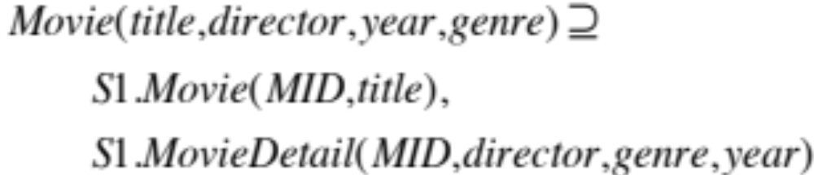
Global-as-View (GAV)
Mediated schema defined as a set of views over the data sources
Movie: title, director, year, genre
S1
Movie(MID,title)
Actor(AID, firstName, lastName, nationality, yearofBirth)
ActorPlays(AID, MID)
MovieDetails(MID, director, genre, year)

Slide 23
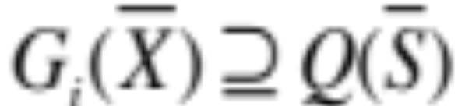
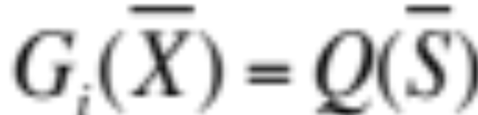
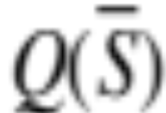
GAV: Formal Definition
A set of expressions of the form:
or
open-world
assumption
closed-world
assumption
G_{i}: relation in mediated schema
: query over source relations

Slide 24
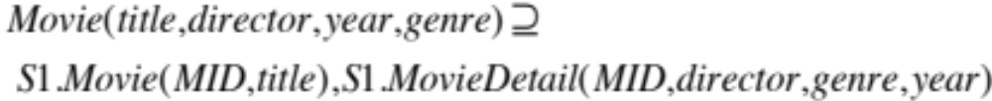
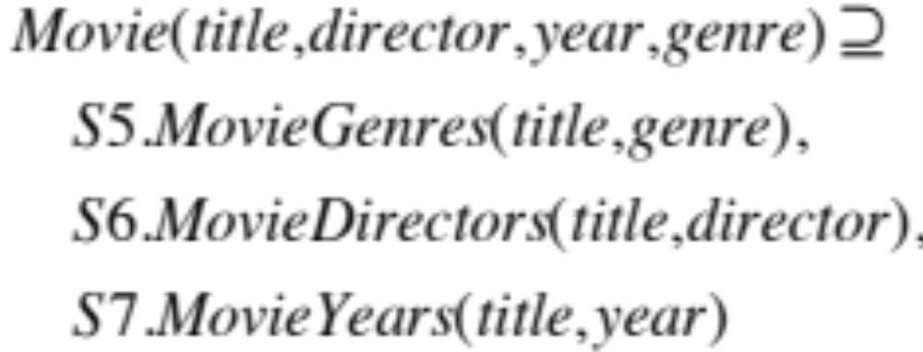
GAV Example
Movie: title, director, year, genre

Slide 25
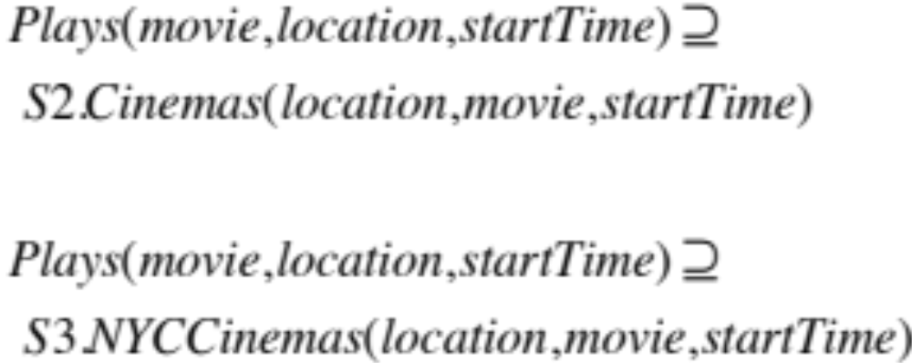
GAV Example (cont.)
Plays: movie, location, startTime
S2
Cinemas(place, movie, start)
S3
NYCCinemas(name, title, startTime)

Slide 26
Reformulation in GAV
Given a query Q on the mediated schema:
  Return the best query possible on the data sources.

Slide 27
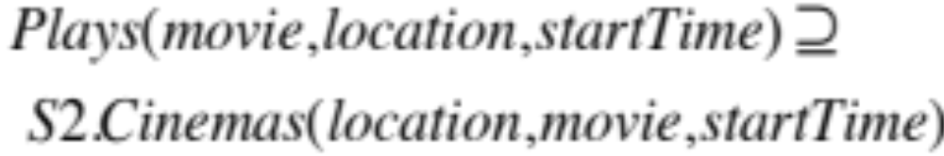
Reformulation in GAV
= Query/View Unfolding
Q(title, location, startTime) :-
Movie(title, director, year, “comedy”),
Plays(title, location, st), st ≥ 8pm

Slide 28
First Reformulation
Q(title, location, startTime) :-
Movie(title, director, year, “comedy”),
Plays(title, location, st), st ≥ 8pm
Q’(title, location, startTime) :-
S1.Movie(MID, title),
S1.MovieDetail(MID, director, “comedy”, year)
S2.Cinemas(location,title, st), st ≥ 8pm

Slide 29
Another Reformulation
Q(title, location, startTime) :-
Movie(title, director, year, “comedy”),
Plays(title, location, st), st ≥ 8pm
Q’(title, location, startTime) :-
S1.Movie(MID, title),
S1.MovieDetail(MID, director, “comedy”, year)
S3.NYCCinemas(location,title, st), st ≥ 8pm

Slide 30
Certain Answers (recall definition)
Q
Mediated Schema (G)
Mapping M
S₁
S₂
S_{n}
Source
instances
s₁
s₂
s_{n}
t ∈ Q(s₁, …, s_{n}) iff
t ∈ Q(g) for ∀g, s.t. (g,s₁,…s_{n}) ∈ M_{R}

Slide 31
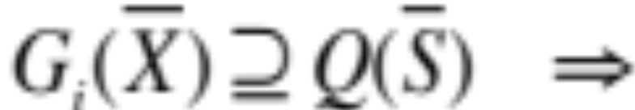

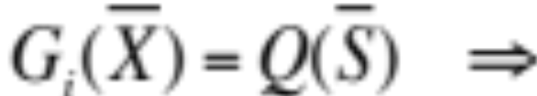
Semantics of GAV
G
S₁, …, S_{n}
(g, s₁,…, s_{n}) ∈ M_{R} if:
g
s₁, …, s_{n}
The extension of in g is a super-set of
evaluating Q_{i} on the sources.
The extension of in g is equal to
evaluating Q_{i} on the sources.

Slide 32
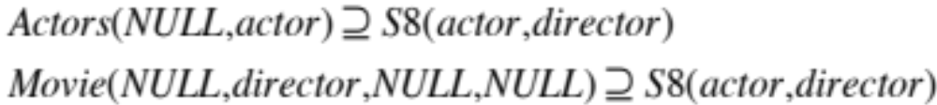
Tricky Example for GAV
S8: stores pairs of (actor, director)
Movie: title, director, year, genre
Actors: title, name
Plays: movie, location, startTime
Reviews: title, rating, description

Slide 33
Tricky Example for GAV
Given the S8 tuples:
({Keaton, Allen}, {Pacino, Coppola})
We’d get tuples for the mediated schema:
Actors: ({NULL, Keaton}, {NULL, Pacino})
Movie: ({NULL, Allen, NULL, NULL},
{NULL, Coppola, NULL, NULL})

Slide 34
Tricky Example (2)
Actors: ({NULL, Keaton}, {NULL, Pacino})
Movie: ({NULL, Allen, NULL, NULL},
{NULL, Coppola, NULL, NULL})
Can’t answer the query:
Q(actor, director) :-
Actors(title, actor),
Movie(title, director, genre, year)
LAV (Local as View) will solve this problem

Slide 35
GAV Summary
Mediated schema is defined as views over the sources.
Reformulation is conceptually easy
  Polynomial-time reformulation and query answering.
GAV forces everything into the mediated schema’s perspective:
  Cannot capture a variety of tabular organizations.

Slide 36
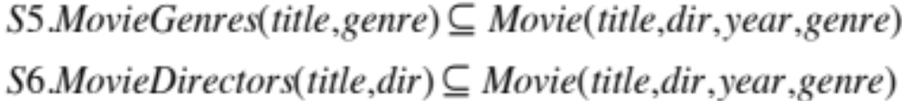
Local-as-View (LAV)
Data sources defined as views over mediated schema!
S5
MovieGenres(title, genre)
Movie: title, director, year, genre
Actors: title, name
S6
MovieDirectors(title, dir)
Plays: movie, location, startTime
S7
MovieYears(title, year)
Reviews: title, rating, description

Slide 37
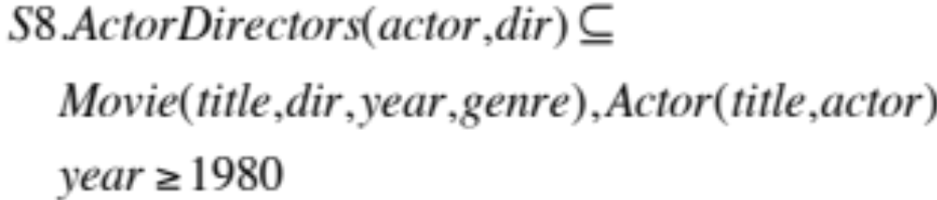
Local-as-View (LAV)
Data sources defined as views over mediated schema!
Movie: title, director, year, genre
S8
ActorDirectors(actor,dir)
Actors: title, name
Plays: movie, location, startTime
Reviews: title, rating, description

Slide 38
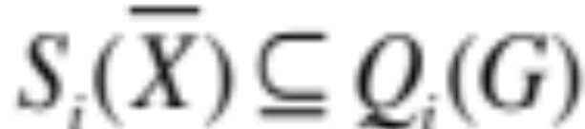
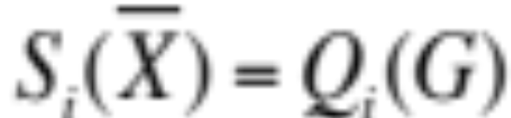
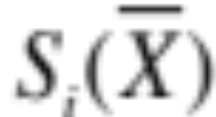
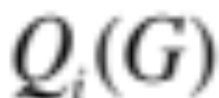
LAV: Formal Definition
A set of expressions of the form:
or
closed-world
assumption
open-world
assumption
: source relation
: query over mediated schema

Slide 39
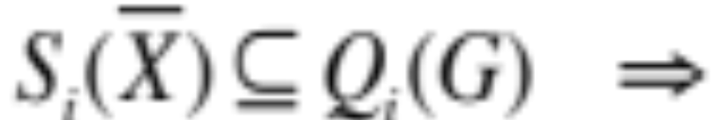

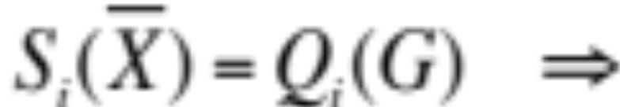
Semantics of LAV
G
S₁, …, S_{n}
(g, s₁,…, s_{n}) ∈ M_{R} if:
g
s₁, …, s_{n}
The result of over g is a superset of s_{i}.
The result of over g equals s_{i}.

Slide 40
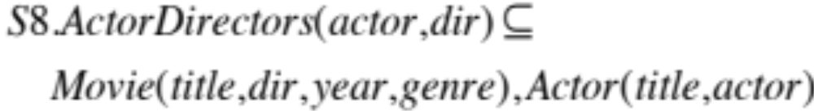
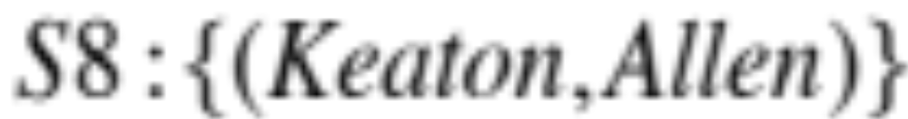
Possible Databases
Unlike GAV, LAV definitions imply a set of possible databases for the mediated schema.
Two possible databases for the mediate schema are:
Movie: {(“manhattan”, allen, 1979, comedy)}
Actor:{(“manhattan”, keaton)}
Movie: {(“foobar”, allen, 1979, comedy)}
Actor:{(“foobar”, keaton)}

Slide 41
Possible Databases
Since the source may be incomplete, other tuples may be in the instance of the mediated schema:
Movie: {(manhattan, allen, 1981, comedy),
(leatherheads,clooney,2008, comedy)}
Actor:{(manhattan, keaton),
(the godfather, keaton)}

Slide 42
Certain Answers: by now you know this slide by heart
Q
Mediated Schema (G)
Mapping M
S₁
S₂
S_{n}
Source
instances
s₁
s₂
s_{n}
t ∈ Q(s₁, …, s_{n}) iff
t ∈ Q(g) for ∀g, s.t. (g,s₁,…s_{n}) ∈ M_{R}

Slide 43
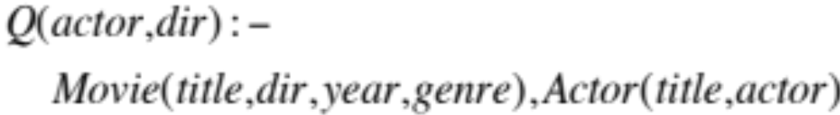
Certain Answers Example 1
Only one certain answer: (Keaton, Allen)

Slide 44
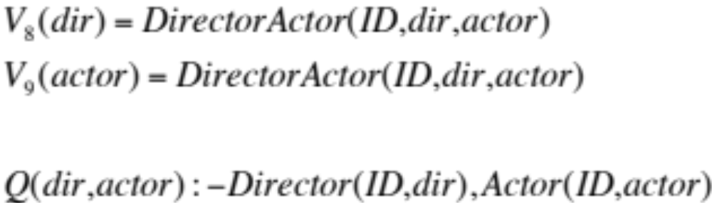
Certain Answers Example 2
{Allen}
{Keaton}
Under closed-world assumption:
single DB possible ⇒ (Allen,Keaton)
Under open-world assumption:
no certain answers.

Slide 45
Reformulation in LAV
We’re given tuples for sources
(expressed as views)
S₁
S_{i}
S_{n}
…
…
Mediated schema
(but no tuples)
Query over mediated schema
This is exactly the problem of:…
Answering queries using views!

Slide 46
Local-as-View Summary
Reformulation = answering queries using views
Algorithms work well in practice:
  Reformulation is not the bottleneck
Under some conditions, guaranteed to find all certain answers
  In practice, they typically do.
LAV expresses incomplete information
  GAV does not. Only a single instance of the mediated schema is consistent with sources.

Slide 47
LAV Limitation
Movie: title, director, year, genre
S1
Movie(MID,title)
Actor(AID, firstName, lastName,nationality,yearofBirth)
ActorPlays(AID, MID)
MovieDetails(MID, director, genre, year)
If a key is internal to a data source, LAV
cannot use it.
So…

Slide 48
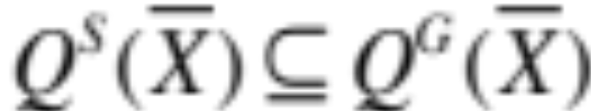
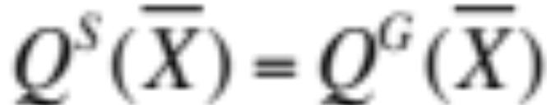
GLAV
[The Best of all Worlds*]
A set of expressions of the form:
or
Q^{G}: query over mediated schema
Q^{S}: query over data sources
*Apologies to the acronym Gods…

Slide 49
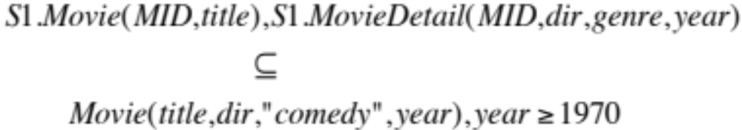
GLAV Example

Slide 50
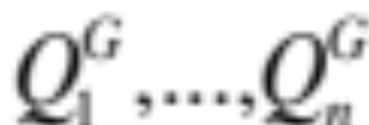
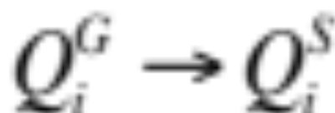
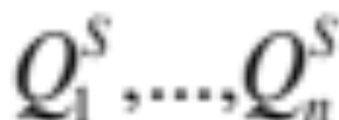
Reformulation in GLAV
Given a query Q
Find a rewriting Q’ using the views
Create Q’’ by replacing:
Unfold

Slide 51
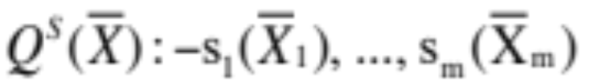
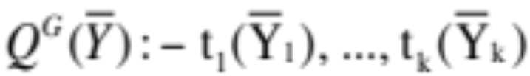
An Alternative Notation for GLAV:
Tuple Generating Dependencies
Tuple generating dependencies (Chapter 2.1.2) can be used to specify GLAV expressions.
The TGD
is equivalent to the GLAV expression:
where:

Slide 52
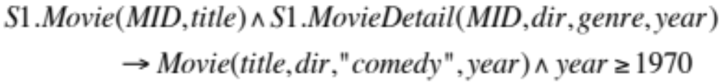
GLAV -> TGD Example
➔
Reformulation with TGD descriptions can be done relatively directly with the Inverse Rules Algorithm (See Chapter 3.2.5).

Slide 53
Outline
Introduction to semantic heterogeneity
Schema mapping languages
Access pattern limitations
Integrity Constraints on the mediated schema
Answer completeness
Data-level heterogeneity

Slide 54
Access-Pattern Limitations
Often we can only access the data sources in specific ways:
  Web forms: require certain inputs
  Web services: interface definitions
  Controlling load on systems: allow only limited types of queries
Model limitations using adornments:
  V^{bf}(X,Y): first argument must be bound

Slide 55
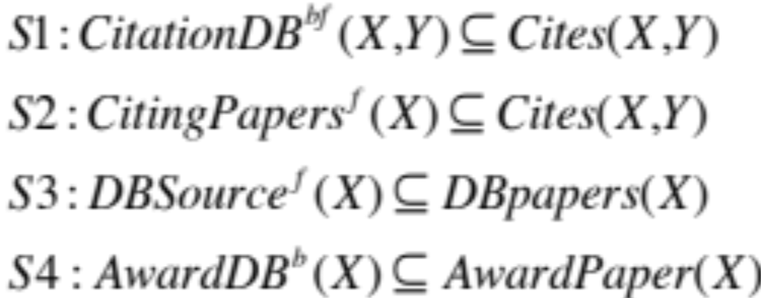
Example Binding Patterns
Cites(X,Y)
DBPapers(X)
AwardPaper(X)

Slide 56
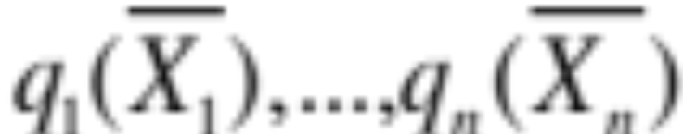
Executable Plans
conjunctive plan:
adornments: BF_{i} for q_{i}
Plan is executable if there are bf_{i} ∈ BF_{i} s.t.
If X is in position k of q_{i}, and bf_{i} has ‘b’ in
k’th position, then X occurs earlier in the
plan.
i.e., every variable that must be bound has a value.

Slide 57
Example (1)
Cites(X,Y)
DBPapers(X)
AwardPaper(X)
Q(X) :- Cites(X,001)
X
Q’(X) :- CitationDB(X,001)
Q’(X) :- CitingPapers(X),CitationDB(X,001)

Slide 58
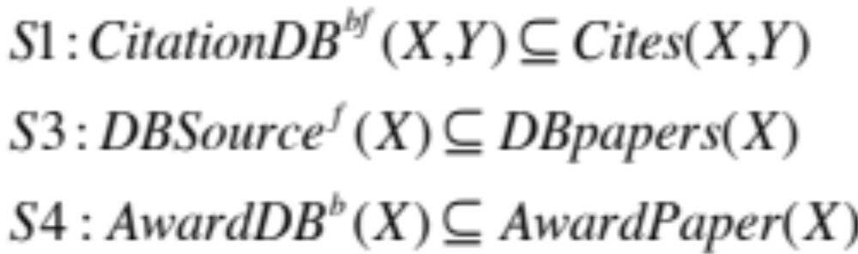
Example (2): cannot bound the length of a possible rewriting!
Cites(X,Y)
DBPapers(X)
AwardPaper(X)
Q(X) :- AwardPaper(X)
Q’(X) :- DBSource(X),AwardDB(X)
Q’(X) :- DBSource(Y),CitationDB(Y,X),AwardDB(X)
Q’(X) :- DBSource(Y),CitationDB(Y,X₁),…,
CitationDB(X_{n},X), AwardDB(X)

Slide 59
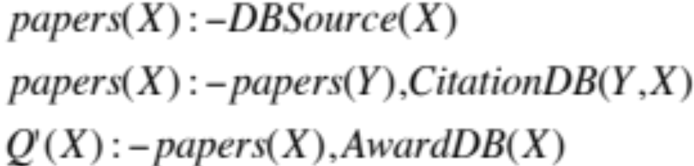
Recursive Plans to the Rescue
Theorem: this can be done in general
[Duschka, Genesereth & Levy, 1997]

Slide 60
Outline
Introduction to semantic heterogeneity
Schema mapping languages
Access pattern limitations
Integrity Constraints on the mediated schema
Answer completeness
Data-level heterogeneity

Slide 61
Integrity Constraints
In the presence of integrity constraints on the mediated schema, the reformulation algorithms may need to be modified.
Next, an example in the context of Local-as-View.
See an example for Global-as-view in Chapter 3.4.2.

Slide 62
Integrity Constraints with LAV
Mediated schema:
Schedule(airline, flightNum, date, pilot, aircraft)
Functional dependencies:
Pilot → Airline and Aircraft → Airline
Data source:
S(date,pilot,aircraft) ⊆
schedule(a,fN,date,pilot,aircraft)
Query: (pilots in same airline as Mike)
q(p) :- schedule(a,fN,date,”mike”,aircraft)
schedule(a,f,d,p,a)
Without functional dependencies, no answers!

Slide 63
But We Do Have Answers…
Date | Pilot | Aircraft
1/1 | Mike | 111
5/2 | Ann | 111
1/3 | Ann | 222
4/3 | John | 222
Mike and Ann work for the same airline
111 and 222 belong to the same airline
John and Ann work for the same airline, …

Slide 64
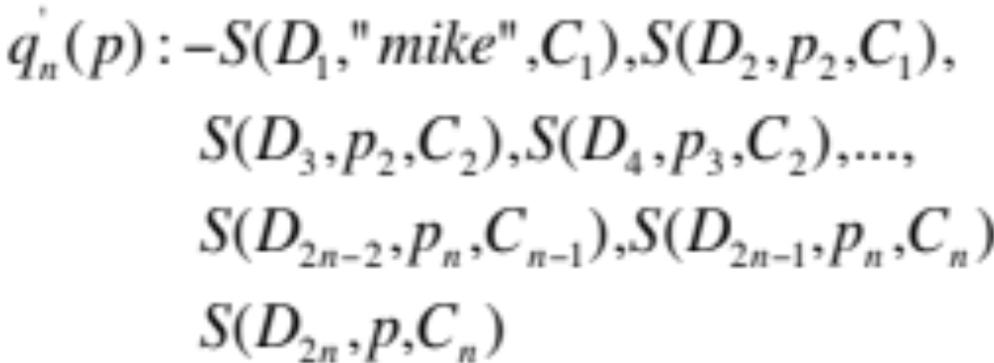
No Limit to Rewriting Size
Does this sound familiar?
Recursive plans to the rescue!

Slide 65
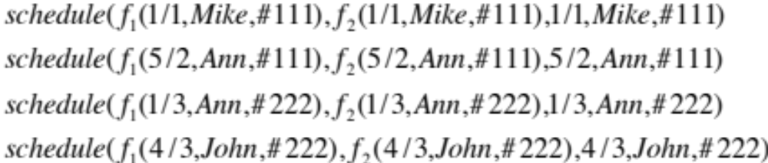
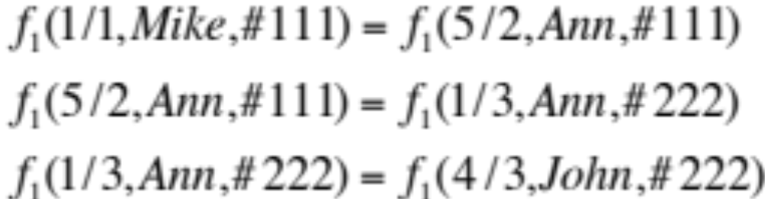
Recursive Plan
Start with inverse rules and get:
But we know that:

Slide 66
The e relation
Let’s define a relation e(X,Y) that stores all pairs that are actually equal.
e(x,x) – holds for every x.
The other rules for inferring e(X,Y) are derived from the functional dependencies.
Add: e(X,Y) :- e(X,Z), e(Z,Y)

Slide 67
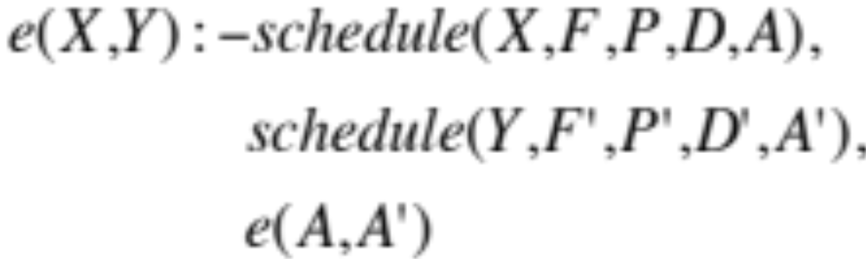
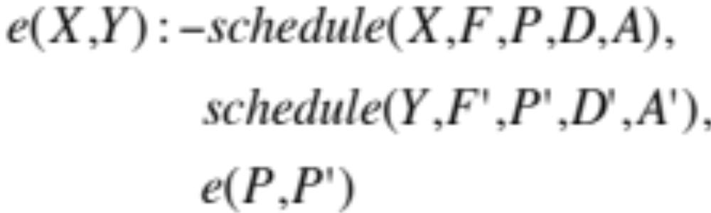
The Rules
Aircraft → Airline: So…
Pilot → Airline: So…

Slide 68
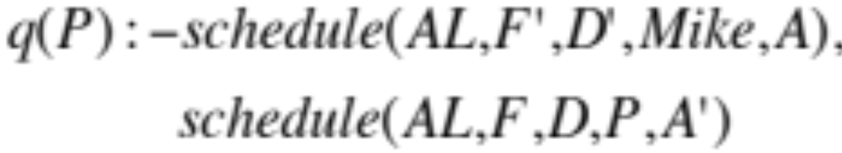
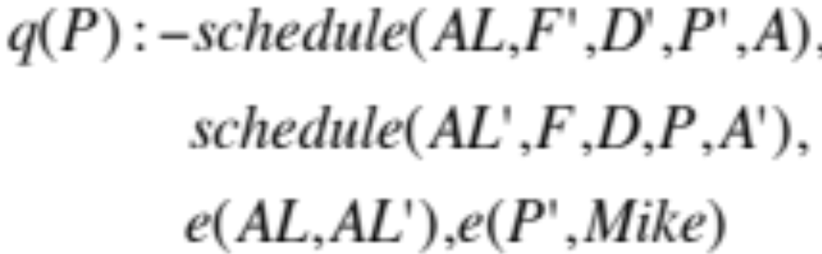
One More Step
Reformulate the query to use e(X,Y):

Slide 69
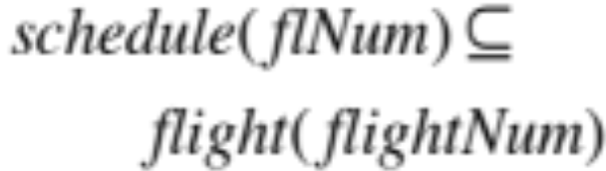
Integrity Constraints in GAV
Airline | flNum | Date | Pilot | Craft
United | 111 | 1/1 | Mike | 15
SAS | 222 | 1/3 | Ann | 17
flightNum | Origin | Dest
222 | Seattle | SFO
333 | SFO | CPH
q(fn) :- schedule(airline, fN, date, pilot, aircraft)
flight(fN, origin, destination)
111 should be in the answer, but won’t.

Slide 70
Outline
Introduction to semantic heterogeneity
Schema mapping languages
Access pattern limitations
Integrity Constraints on the mediated schema
Answer completeness
Data-level heterogeneity

Slide 71
Local Completeness
We’ve modeled complete sources with GAV/LAV/GLAV
Often, sources are only partially complete:
  Online movie db is complete only w.r.t recent movies
  My bib file is complete only w.r.t. data integration
We need to model local completeness
Question: given partially complete sources:
  Is the answer to a query Q complete?

Slide 72
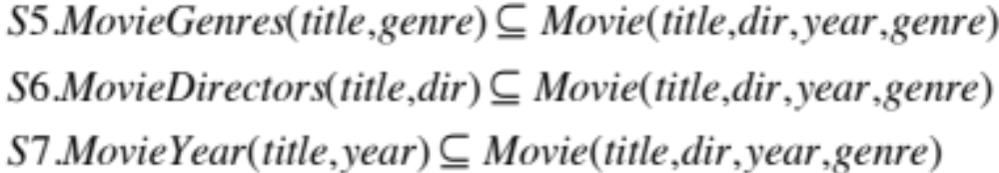
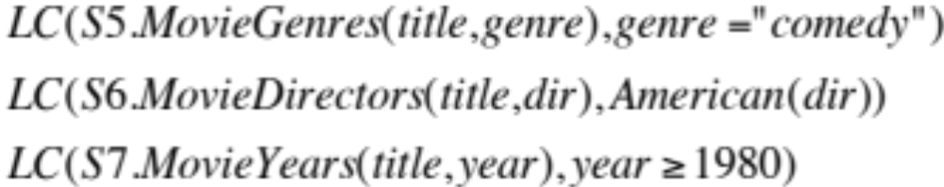
Modeling Local Completeness
We model local completeness with LC statements of the form:

Slide 73
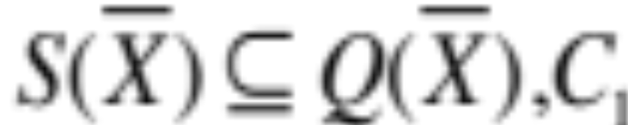
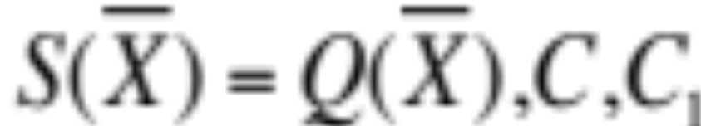
Formally
Given a LAV description:
We define LC with a constraint C
on the arguments of the source S:
LC(S,C).
Semantics: add the following to source
description:

Slide 74
Answer Completeness
Is the answer to Q complete, given the sources?

X
Detecting answer completeness can be reduced to a query containment problem.

Slide 75
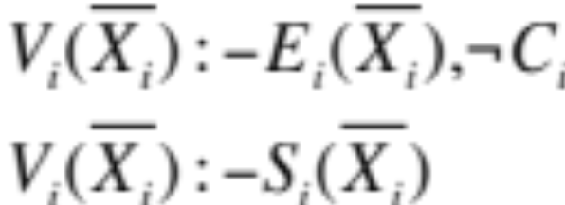
Algorithm for Detecting Answer Completeness
Given:
Assume E_{i} are new relation names, and define
Let Q be a conjunctive query
Define Q’ by replacing S_{i} in Q by V_{i}
Q is answer-complete iff Q is equivalent to Q’.

Slide 76
Outline
Introduction to semantic heterogeneity
Schema mapping languages
Access pattern limitations
Integrity Constraints on the mediated schema
Answer completeness
Data-level heterogeneity

Slide 77
Data-Level Heterogeneity
Huge problem in practice:
  Data coming from different sources rarely joins perfectly.
Differences of scale:
  Celsius vs. Fahrenheit
  Numeric vs. letter grades
  First Name, Last Name vs. FullName
  Prices with taxes or without
  …

Slide 78

Mappings with Transformations

Slide 79
Reference Reconciliation
Multiple ways to refer to the same real-world entity:
  John Smith vs. J. R. Smith
  IBM vs. International Business Machines
  Alon Halevy vs. Alon Levy
  South Korea vs. Republic of Korea
Create concordance tables:
  Pairs of corresponding values
  How? See the next chapters!

Slide 80
Summary of Chapter 3
Source descriptions include:
  Schema mappings
  Completeness, access-pattern limitations
  Data transformations
  Additional query-processing capabilities
Schema mapping languages
  GAV: reformulation by unfolding
  LAV/GLAV: reformulation by answering queries using views
Binding patterns and integrity constraints can lead to tricky cases:
  Recursive rewritings can often address these.

